Slide 1


PLEDGE TO PROGRESS Sustainability Hackathon
Sponsored By
Your Team Name : AIDivers
Your team bio : Deepak Baluni, System Integration Advisor at NTT Data
Jyoti Dagar, Tech Lead at Nagarro
Ashwani Dagar, Social Activist & learner
Date : 24th April 2023

Slide 2
Problem Statement
As we all know that education is the very basic need of every individual and despite of this many students get deprived of it especially from rural areas. With our proposed platform, we will try to full fill this gap with an approach that would be totally flexible as per the student. There won’t be just the standard norms and instead user would have the flexibility for the personalized learning, self evaluation etc that differentiates it from the available platforms. Below are the activities that can be performed on the platform by registered users:
enroll for the available courses & track progress
predict possible career at the end of courses considering performance so far if students are not satisfied with the result, they can go for recommended courses to improve their score
self evaluation can be taken by students themselves to test their knowledge(no need to depend on teacher's quiz or test)
feedback on the courses and use of sentiment analysis in order to get the trending courses
creating social awareness on the garbage classification where they can learn Reuse, Recycle and Reduce concepts by simply uploading garbage image and learning on the go and help environment
diagnose their diet in order to stay healthy and active following some recommendations
educating rural children with modern farming methodologies

Slide 3
User Segment & Pain Points
Our solution “Go-Eazzzy-Brain” will majorly target the students where they can take advantage of our platform which will make the learning on the go possible along with so much varied features like self evaluation, diet analysis & environmental awareness activities.

Slide 4
Tools or resources
1. Azure cognitive services like custom visoin and others for achieving ML goals 2. Visual Studio/ visual Studio Code 3. SQL Server 4. GitHub

Slide 5
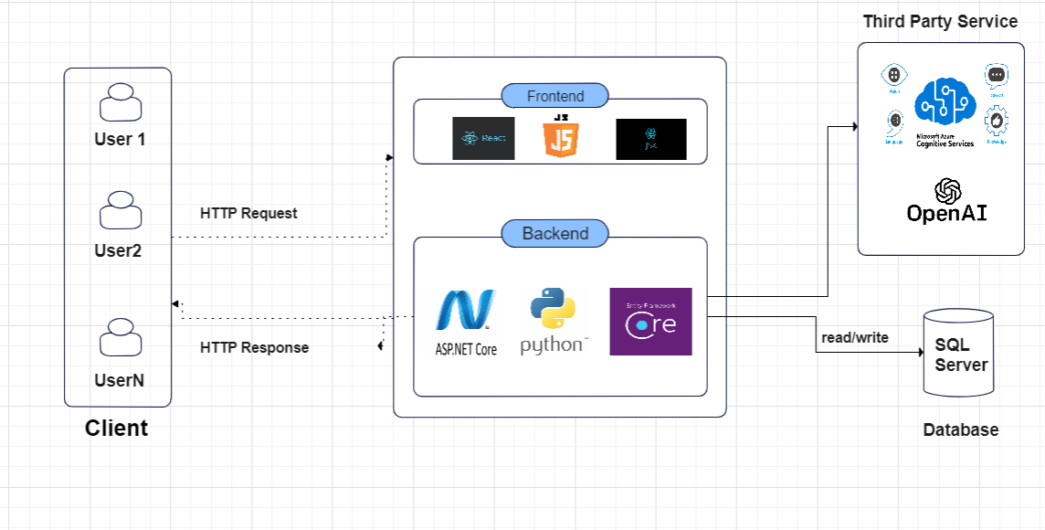
Web App Architecture

Slide 6
Key Differentiators & Adoption Plan
Our solution is keenly focused on the user’s personalized learning along with the AI/ML technologies , thus making it more flexible and differntiating it from the existing solutions.
It would be a web app with below tech stack.
Proposed Tech stack:
Frontend – React Js with JavaScript
Backend - .NET Core / Python
Database – SQL Server
Source Code Repo – GitHub

Slide 7
GitHub Repository Link
Go-Eazy-Brain/README.md at main · DagarJ/Go-Eazy-Brain (github.com)

Slide 8
Thank You
Jyoti Dagar, Deepak Baluni, Ashwani Dagar

